Slide 1



Getting Started with F#
Dave Cook
@dcook_net
@cookie
Notes:
Hello, I’m Dave Cook, A senior engineer at CompareTheMarket.com
Today I’m going to give an overview of F#, and hopefully give you both the desire, and the tools you need to get started.
I'll try and answer questions at the end, as we have a lot to cover.
I’ll share the url to a repo with all the slides and code, so no need to take screen shots.
Before that, just a little bit about me and where I’m coming from:

Slide 2
How I came to functional programming and F#
Spoiler alert: It’s Jon Skeet’s Fault!
@dcook_net
@cookie
Notes:
I’d probably describe myself as a predominantly .Net, backend Dev, although I do dabble with Python and Node from time to time.
I’ve spent the last 5-ish years building and maintaining a suite of microservices in .Net Core, C#, Docker and Mongo.
Before that, I used the .Net Framework in a variety of ways: including VB.net, WFC and Web Forms.
More recently, I’ve picked up F# and functional programming, which is teaching me new ways of thinking and approaching problems and having a profound impact on the way I write code when not using F#.
I came to F# via a perfect storm of luck and frustration!
I while ago, I was teaching myself Node and JavaScript, and I was getting more and more frustrated; partly due to the developer experience and things like poor intelisence, but mostly with the language itself….or what I should say: “with how I was trying to use the language!”
I now realise, having learnt some F#, that this was all down to me and how I was approaching things; trying to translate object-oriented C# into JavaScript and expecting the same experience was probably a mistake, and tainted my experience.
So, frustrated, I decided to put Node down to do something else,…

Slide 3
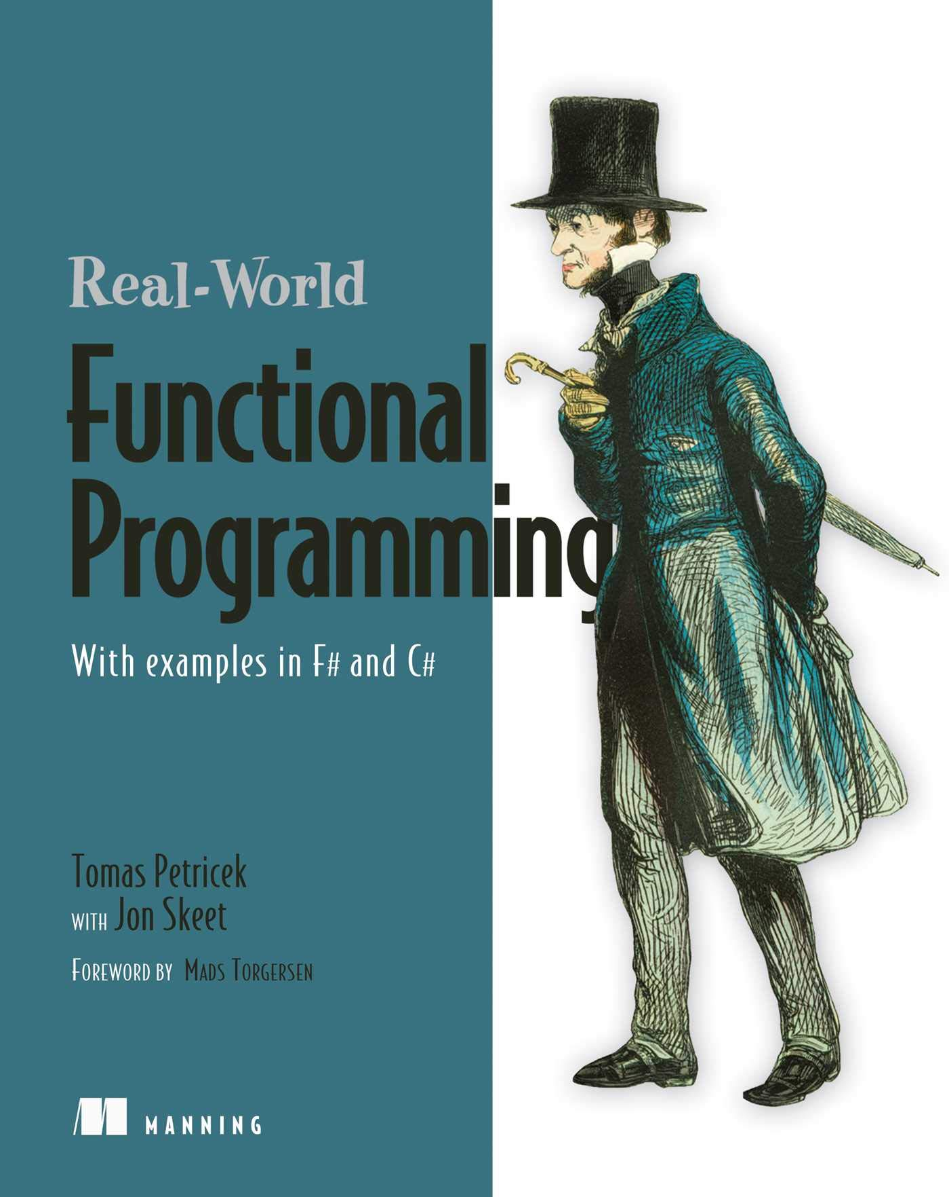
Tomas Petricek
@tomaspetricek
Notes:
and spent the last of my training budget on something different. I was browsing through Manning’s catalogue, when I came across this book: “Real World Functional Programming”, co-authored by none other than Jon Skeet!
Now I’d read “C# in Depth” and learnt tonnes, so I was sold!
It arrives, and honestly, I couldn’t put this thing down. I was hooked from day one!
And to be honest, I can’t even tell you what I actually learned from that book…I didn’t even finish it before I ordered ‘Get Programming in F#’ by Isaac Abraham.

Slide 4
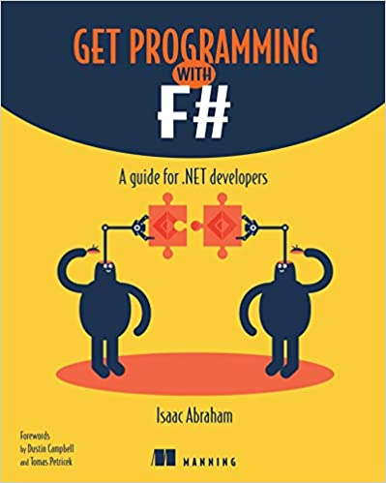
Isaac Abraham
@isaac_abraham
Notes:
Ever since then I have been moving more and more in the direction of Functional programming, applying functional techniques to C#, Python, and JavaScript, and teaching myself F#.
Which is how I arrived here, talking today.
Now before we go any further, I feel compelled to say that I am by no means an expert in F# or functional programming.
I don’t use F# in my day job, unfortunately…. well, maybe a few cheeky additions here and there…. I’ll explain that later!
I’m an enthusiastic hobbyist, or an advanced beginner!
I’ve never built a production application with F#, and most of what I know comes from reading books, watching talks online, and playing with code in my spare time.
So the aim of today’s talk is to get you interested in F#, give you a taste of what if can offer, and hopefully give you a boost to starting your own F# journey.
Anyway, enough about me!
Let’s crack on.

Slide 5
What is F# and what can I use it for?
F# Overview
‘Functional-First’ flavour of .Net
General purpose
Statically typed
Range of uses:
Web, desktop, console app, scripting, nuget packages, global tools
Notes:
What is F#? And What can I use it for?
F# is Microsoft’s ‘Functional-First’ flavour for .Net.
It’s a general purpose, cross platform, statically typed programming language, that can be used for everything from web api, to desktop applications, nuget packages, console applications, global tools, and scripting.

Slide 6


Full Stack F#
F# Overview
Notes:
It’s actually possible to go Full Stack using just F# to build both the Back AND the front ends (using things such as SAFE Stack and Fable and Bolero, which transpile to generate your javascript for you),
And all the automation that manages your build and infrastructure can be written in F# too.

Slide 7

Not just Data Science, ML and maths!
F# Overview
Notes:
F# is not just for Data Science, Machine Learning and pure maths as you may have heard!

Slide 8
Just the F#cts please!
F# Overview
Open-source
Mature/Stable
V5 released last year with .Net 5
V6 release due with .Net 6
Runs everywhere you execute .Net code today
Notes:
As with the .Net runtime, it’s open-source, and it’s been around since 2005, so it’s a stable and mature platform.
The latest version is F# 5, which was released last year with .Net 5, and version 6 will land with .Net 6
And because it sits on top of the .Net Runtime, it runs in your favourite IDE, will run everywhere you currently execute .Net code, including Docker, AND…. it’s already installed on your machines*, so you really have no excuses for not giving it a try ☺

Slide 9
Interoperable with C# *
F# Overview
Compiles down to IL
Can still use your favourite nuget packages **
Create hybrid solutions using F# and C#
* Not 100% interoperable.
** Though you may not want to use them anymore! ☺
Notes:
Not only that, but it’s also interoperable** with other .Net languages, because it compiles down to IL, so you can continue to use your favourite packages from Nuget, and you can even create hybrid solutions containing multiple .Net languages. You CAN consume F# from C#, and visa-versa.

Slide 10
Interoperable with C#
F# Overview
Consume F# record types from C#
Tests in F#, production code in C#
Notes:
So a couple of those cheeky ways in which I have used F# at work is to:
create an F# project for defining record types, and then consuming those records from within C#...this was prior to C# 9…. So if you are not lucky enough to be using C# 9 yet, but want to use record types, you can do this now! F# has had them for ages!!!
I’ve also created F# projects to house some Property Based Tests that validate the implementation of a C# projects – I could have done this using C#, but I found that the examples on the web, and the documentation for F# was more comprehensive, and actually a little bit easier to do because of something called a computation expression….(I won’t be talking about Property Based Testing or Computation Expressions today, as they are probably both talks on their own!)

Slide 11
Functional First?!??
F# Overview
F# & C# both support Functional and OO styles
F# towards Functional, C# leans towards OO
Data and Behaviours decoupled by design
F# supports mutation, classes, inheritance and interface, but these are not the default way of working
Notes:
So, I said that ‘F# is Microsoft’s ‘Functional-First’ flavour for .Net.’
What does that mean?
Well, in a similar way that C# supports both OO and Functional styles of programming, F# supports both paradigms too, giving you the flexibility to use either, or both.
But while C# leans in the direction of OO, F# leans more in the direction of Functional programming.
So you could describe C# as Object Orientated first.

Slide 12
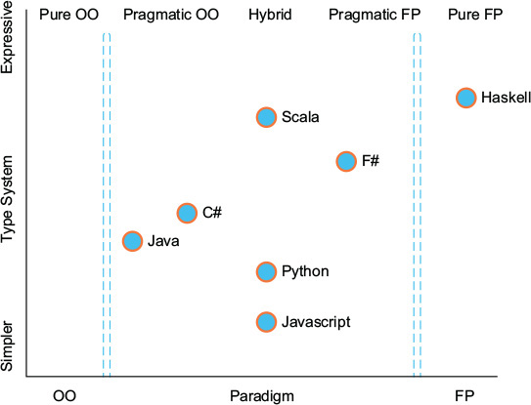
F# Overview
Taken from ‘Get Programming With F#’ by Isaac Abram, 2018, so this refers to C# 7
Notes:
Here’s a diagram taken from ‘Get programming with F#’ showing where C# and F# sit roughly on the axis of Pure OO to pure Functional Programming.

Slide 13
F# Overview
Taken from ‘Get Programming With F#’ by Isaac Abram, 2018, so this refers to C# 7
Notes:
Roughly, because recent additions to C# has had it moving in this direction

Slide 14
What is Functional Programming?
Functional Programming
Takes a different approach to OO:
Data and behaviours decoupled by design
Applications generally composed from functions, not classes.
Notes:
What is Functional Programming?
Functional Programming takes a different approach to Object Oriented programming.
In OO, the focus is on encapsulation or data hiding!... Objects store state, or data, internally, and then expose methods to access or mutate that data over time.
Data and Behaviours are coupled together by design.
In Functional programming, the opposite is generally true.
Data and behaviours are deliberately decoupled, and instead of objects working together with other objects, Functional solutions are built from Functions that generally pass data in, returning different data out…. Lots of small functions, composed together to build larger functions, composed together to build Applications.
So; while F# supports state mutation, classes, inheritance and interfaces… these are not the default way to work.

Slide 15
What is Functional Programming?
Functional Programming
3 Core Principles
Immutability
Expressions
First Class Functions!
Notes:
At the heart of Functional Programming lies 3 Core Principles, which F# embraces:
They are
Immutability
Expressions
First Class Functions!

Slide 16
Immutability
Functional Programming
Once a value is assigned, it can never change
F# provides this out of the box for most Types
Things like thread safety are built in
Notes:
Immutability: Once a value is initialised, it can never change!
Now if you’ve only ever written code that utilises state mutation, this probably seems like a strange concept: How do you get anything done if you can’t change anything?!?
But this is really useful because it eliminates all sorts of weird and wonderful bugs that can only ever happen BECAUSE of mutation! Race conditions for example.

Slide 17
Expressions
Functional Programming
Everything returns something
There is no void
There is no Null
There are no Statements
Everything is an Expression!
Notes:
Expressions: Everything is an expression!
Every operation returns something, a result of some type, something you can then do something with.
There is no void type.
There are no If statements…there are not statements at all!
And in many cases, there is no Null.
This all aids with code composition, which you’ll see soon.

Slide 18
First Class Functions
Functional Programming
Functions are low ceremony:
Easy to create
Easy to use
Can be passed around like values
Are entities in their own right; they don’t need to live on a class
Notes:
First Class Functions: Functions are cheap and easy to create, with low ceremony. They can be used as values, passed as arguments, returned as a result from other functions or stored in data structures.
As we look at the code, you’ll see that F# makes this principle look like an understatement.
...
You can probably see already that Functional programming is quite different from the core principles of OO, and what we C# devs are used to.

Slide 19

What is Functional Programming?
F# Overview
3 Core Principles
Immutability
Expressions
First Class Functions!
Free Your Mind!
Notes:
A Word of warning!
Given that the Principles of Functional programming are fundamentally different to OO, it’s worth pointing out that you will be learning more than just a new language and a different syntax. It’s a different paradigm, which requires a different way of thinking.
Don’t make the mistake I made with JavaScript; You can’t approach this with the mind set of translating the code you would write in C# into F# syntax, as not everything has a one-to-one mapping.
My advice is to approach this with an open mind, in the same way you learnt your first programming language: with curiosity over pre-conceptions.

Slide 20
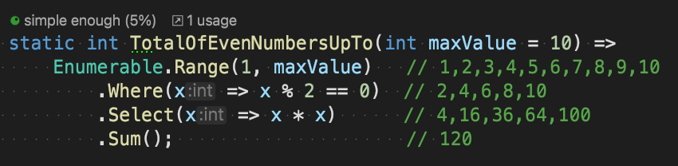
Your already doing Functional Programming!
C#
Notes:
Now, with that little warning …. here’s a little code to ease you in gently. Something you are hopefully all familiar with already, and well within your comfort zone: Linq
Here we have a method that takes in a number as an argument, and then uses that number to generate a sequence,
filter the sequence to find all the odd numbers
Square them
and calculate the sum total.
This is functional programming!
Let’s think back to those 3 core principles:

Slide 21
First class Functions
3 Core Principles of Functional Programming
Notes:
First Class Functions:
Where and Select are themselves Functions, which take other functions as arguments, allowing us to plug in our own behaviour to achieve different results.

Slide 22
First class Functions
3 Core Principles of Functional Programming
Notes:
our lambdas are complete functions, easy to create and use, easy to compose, and supplied as arguments to other functions

Slide 23
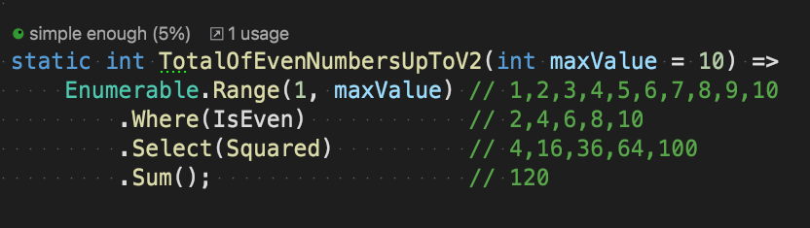
First class Functions
3 Core Principles of Functional Programming
Notes:
Here is the same expression refactored to use existing functions instead of lambdas.

Slide 24
Everything is an Expression!
3 Core Principles of Functional Programming
Notes:
Everything is an Expression:
Enumerable.Range produces a result: a collection of 10 integers

Slide 25
Everything is an Expression!
3 Core Principles of Functional Programming
Notes:
The Where function takes the original collection and returns a new collection

Slide 26
Everything is an Expression!
3 Core Principles of Functional Programming
Notes:
The Select function takes a collection, and returns a different collection

Slide 27
Everything is an Expression!
3 Core Principles of Functional Programming
Notes:
Sum takes the result of Select and adds the values together to return the total

Slide 28
Immutability
3 Core Principles of Functional Programming
Notes:
Finally, Immutability:
Once a value is created, it can’t change
Each of these functions takes its input and uses it to generate its output, but in each case, the original value is unmodified.

Slide 29
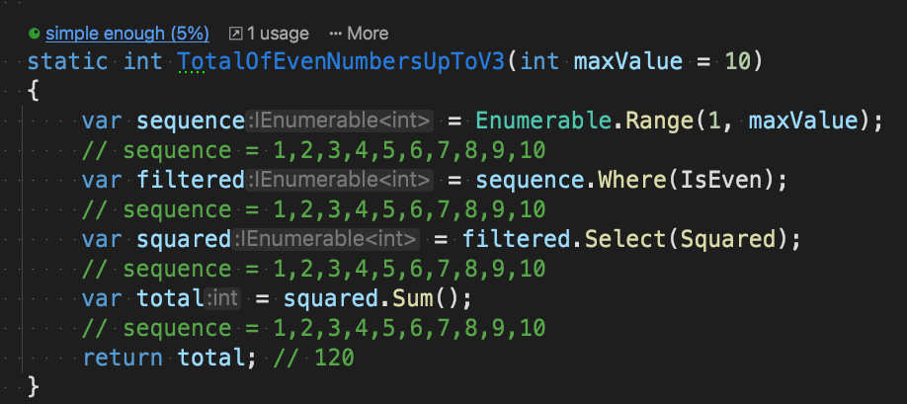
Immutability
3 Core Principles of Functional Programming
Original values remain unchanged via convention in C#!
Notes:
If we inspect the intermediate values in this version of the code, you’ll see that the original values remain unmodified after the subsequent actions execute.
…..
So, if you have used Linq, then you are already familiar with some functional programming techniques.

Slide 30
Time to look at some code
F#
Notes:
Ok, let’s start looking at some F# code.
What I’m going to try and do is show off some of the features that I think makes F# a language worthy of your investment, by showcasing the ways in which it can make our lives as Devs easier.
Some of the highlights:
A powerful Type system, with the feel of a dynamic language.
Safer, less error prone code
We'll Write less code, and tests, but with higher confidence
And we'll favour Simplicity over learning loads of different Design Patterns

Slide 31
Powerful Type System, that gets out of your way
F# Type System
Familiar primitive types: int, decimal, datetime, string
Strongly Typed
Type inference means we rarely need to specify Types
Notes:
We covered that F# is built on top of the .Net Base Common Library (BCL)…
So you already know the common types such as decimals, ints, date times, strings etc
And we already know that its strongly typed like C# or Java, rather than dynamically typed like JavaScript and Python.
However, F#’s compiler is incredibly powerful, and is able to infer what type things are without the need for us to explicitly specify the Types.

Slide 32
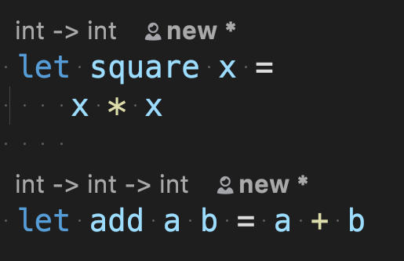
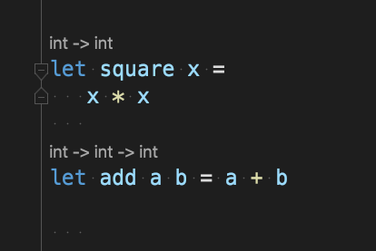
F# Type Inference
Notes:
Here we can see two functions, square and add.
Square accepts a single argument, X, and returns the result of multiplying x by itself.
Add accepts two arguments and returns the result of multiplying the two together.
We’ve not declared any specific Type information, but the compiler inferred from what we are doing that all the input arguments are integers, and as a result, the return types are also integers.

Slide 33
F# Type Inference
Notes:
We can see this highlighted by our IDE just above the function declaration; the Type signature of the functions.
It tells us that square takes an int, and returns an int, while Add takes an int, followed by another int, and then returns an int.
So the compiler is able, in most cases, to tell which Types are required when calling a function, even though no types are specifically declared.
This means that the code we write is light weight, or low noise.

Slide 34
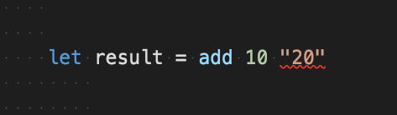
F# Type Inference
//The type ‘string’ does not match the type ‘int’
Notes:
And of course….it’s type safe, so If we try to invoke the function with the wrong type, we get a compiler error:
This is particularly useful, when we create higher-order functions (functions that accept other functions as inputs or return functions as outputs)… something you’ll be familiar with if you’ve ever used the Func or Action delegates in C#.

Slide 35
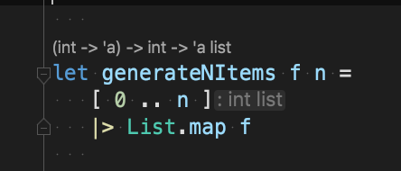
F# Type Inference
Notes:
Here we have function called generateNItems, which takes in 2 arguments: f and n.

Slide 36
F# Type Inference
Notes:
And above the function declaration, we can see that the compiler has inferred from what is going on in the body of the function that f is a function (indicated by the brackets) that accepts an integer, and returns a generic of Type A…. you can think of the A as the T you would refer to when using generics in C#.
It’s also inferred that N is an integer, and that the result of this function is a list of A’s.
So how has it inferred this from the two lines in the body?

Slide 37
F# Type Inference
Notes:
Well, line 1 generates a list of integers from 0 to N, so it’s worked out N must be and integer from that.

Slide 38
F# Type Inference
Notes:
It then pipes that list of numbers into the List.Map function, which is similar to Linq’s Select function; so it applies the supplied function to each item in the list. Therefore, the input argument of that function must be an integer.
There is no explicit return needed, the last line of the function is the result that gets returned to the caller… so the result is a list of A, whatever A is…that will depend on the supplied function!
You can see there is a lot going on here with very little noise to distract you.
This declarative style allows you to write code that says what it is doing, without out getting lost in the detail of how it is doing it.
…
…

Slide 39
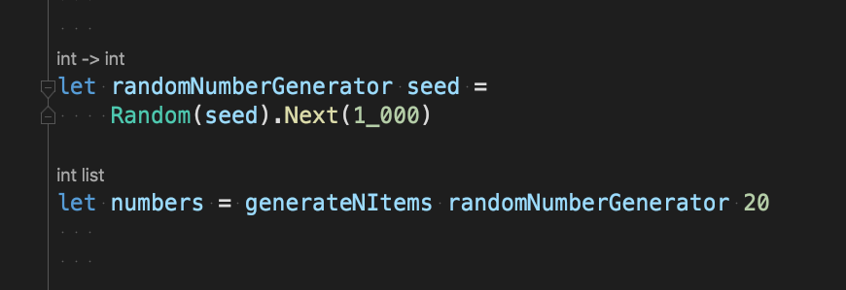
F# Type Inference
Notes:
Here’s our function being invoked (on the last line).
We supply it with a function and the number 20 as our inputs.

Slide 40
F# Type Inference
Notes:
If we inspect the signature of the randomNumberGenerator function, it does indeed require a single integer argument as input…..and the output….well, it doesn’t really matter as requirement was a generic, but our concrete type is also integer.

Slide 41
F# Type Inference
Notes:
The result of the function call, stored in ‘numbers’, is inferred to be a list of integers….which matches the inferred response of the function.

Slide 42
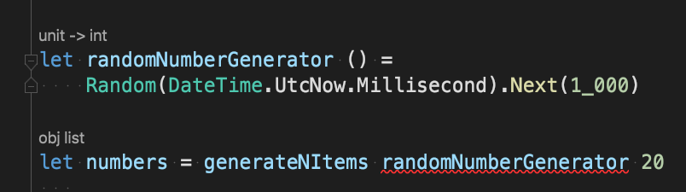
F# Type Inference
// [FS0001] Type mismatch. Expecting a 'int -> 'a' but given a 'unit -> int’
// The type 'int' does not match the type 'unit'
Notes:
And, we still have type safety, so If we had tried to pass this implementation of the randomNumberGenerator to our generateNItems function, then we’d get a compiler error telling us that the Type of the input argument doesn’t match what is expected.
…

Slide 43
Powerful Type System, that gets out of your way
F# Type Inference
Best of both:
Safety of a strongly Typed language
Light-weight expressiveness of dynamic language
Notes:
Hopefully, this demonstrates that F# gives you the best of both;
the safety of a strongly Typed language such as C#,
as well as the light-weight expressiveness of a dynamically typed language.

Slide 44
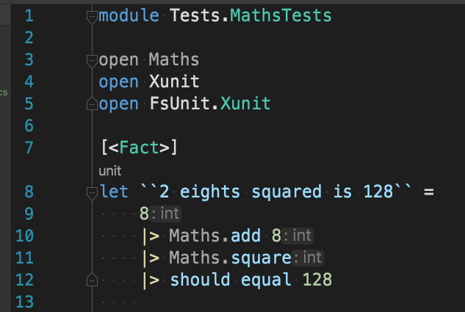
F# Module System – First Class Functions
Notes:
Before we move on, if we zoom out a little and take another look at those add and square Functions, you’ll notice that they don’t belong to a class.
They simply live in the Maths module as entities in their own right.
Calling them is low ceremony, as there’s no need to instantiate anything, or refer to a Type to which they belong.
We can remove the Maths prefix from the call sight in this example (you can see them greyed out on lines 10 & 11) as we’ve already added a reference to the module where they live

Slide 45
Algebraic Type System: not as scary as it sounds!
F# Type System
Scott Wlaschin * refers to the ‘composable Type system’
Compose Types together to create larger Types
Compose those larger Types together to create even bigger, and so on…
See FSharpForFunAndProfit.com or Domain Modelling Made Functional
Notes:
Let’s delve deeper into the Type system now.
On top of the .Net BCL, F# also has what is known as an Algebraic Type System…. this might sound a bit Mathsy and scary. It’s not.
I’ll borrow Scott Wlashchin’s alternative name: he calls it a “composable type system”.
And what he means by this is that you can compose smaller types together to create larger types, and you can compose these together to create even larger types.

Slide 46
Algebraic Type System: So, what!?!
F# Algebraic Type System
2 ways to compose Types together:
And Types
Or Types (Or Choice Types)
Notes:
Now you might be thinking: Ok – I can do that with objects! ...
However, an algebraic Type system provides two ways to compose types together which Scott describes as AND Types and OR Types, or CHOICE types.

Slide 47
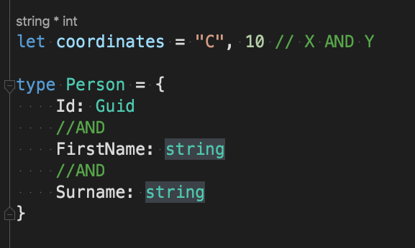
F# Algebraic Type System – And Types
Sometime called Product Types
Notes:
So, our AND types are things like Tuples and Records which you are hopefully familiar with from C#; where you say a
Coordinate is represented by BOTH an X AND a Y value,
and a Person is a combination of an ID AND FirstName AND Surname.

Slide 48
Or Types…one of several options
F# Algebraic Type System – Or Types
Implemented via ‘Discriminated Union’
Allow values to be one of multiple Types
Sometime called Sum Types
Notes:
CHOICE types on the other hand, are implemented using something called a Discriminated Union, and allows us to say that a value, or the result of an expression, can be one of N options.

Slide 49
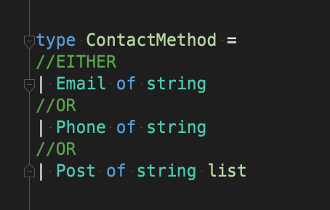
F# Algebraic Type System – Or Types
Notes:
This allows us to say, for example, that a ContactMethod is a choice of either:
Email
Or Phone
Or Post
And each of those options can have its own accompanying data specific to that choice:
Here you can see that the Email and Phone choices both have data on the right, supplied as strings, while the Post choice has data defined with a List of strings, to hold an address.

Slide 50
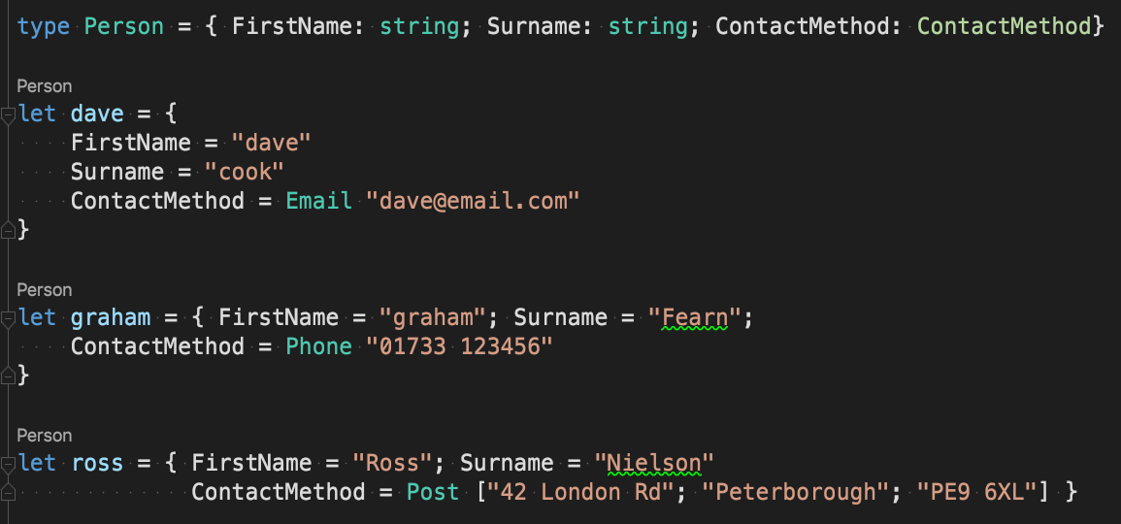
F# Algebraic Type System – Or Types
Notes:
We can compose AND and OR types together like so:
Here we have a Person defined at the top, using a Record Type, which is a combination of FirstName AND Surname AND Contact Method…which is a choice type.
Then below, we create three instances of this type, each with different contact methods specified.
On our first instance, Dave, has set the contact method to the Email Choice, so the accompanying data is a string holding the email address.
Graham would prefer to be contacted by Phone, while Ross is going with snail mail, so the data provided is a list of strings representing the various address parts

Slide 51
Algebraic Type System
F# Algebraic Type System
Different way to model problem domains
Simple alternative to how we would do this in OO
No need for Inheritance or Interfaces
Safer!
Notes:
As you can see, the Algebraic Type system provides us with a completely different way of modelling our problem domains.
If you wanted to model this with objects, how would you do this?
Would you build a God object with all three contact methods as different properties, and a flag indicating which property to use, storing Null for the other properties?
No, you would probably use some sort of inheritance structure, or an Interface with multiple different implementations!
The God object comes with a high probability of errors in the form of null reference exceptions, while also allowing multiple invalid states…, such as setting the flag for Email as the preferred contact method, and then storing a phone number.
Inheritance creates a lot of code, and there be dragons with inheritance that we tend to avoid.
While the interface option creates a layer of indirection that can make it difficult to work out which implementation is being used at runtime.
And neither option scales particularly well, or in a way that helps us fall into the pit of success.

Slide 52
Algebraic Type System
F# Algebraic Type System
Different way to model problem domains
Simple alternative to how we would do this in OO
No need for Inheritance or Interfaces
Safer!
Notes:
Let’s say we introduce more options for Preferred Contact Method, say Twitter, and Facebook.
The God object is now a monster, and the and the problems mentioned before are much worse.
The inheritance and Interface Options add yet more code, scattered about the place, but the Type system doesn’t do anything to help you integrate your new options, or point out your mistakes!
Let’s do this now with F#, and see how can we use a Discriminated Union (Or choice type) to accomplish this.

Slide 53
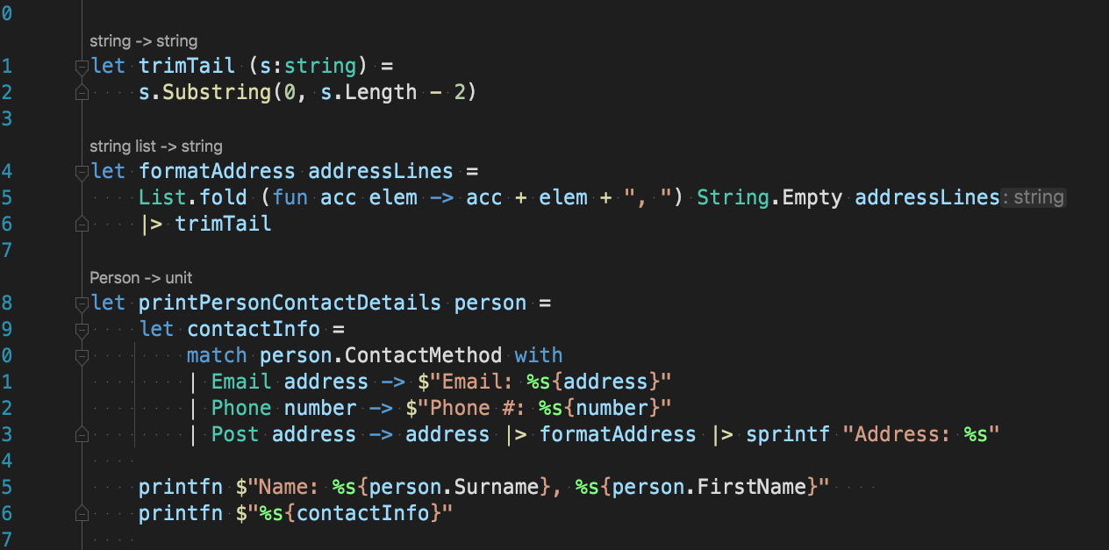
F# Algebraic Type System – Or Types
Notes:
Let’s say we need a way of printing out a Person’s name and contact information:
Here’s how we would do that in F#

Slide 54
F# Algebraic Type System – Or Types
Notes:
We have a function called printPersonContactDeatils with a single input argument of person, which the compiler has inferred to be of our Person type: we’ve not actually told it that.

Slide 55
F# Algebraic Type System – Or Types
Notes:
In here we perform a pattern match on the ContactMethod field of the Person Record, and tell the compiler what to do for each of the available Choices for contact method: Email, Phone and Post.

Slide 56
F# Algebraic Type System – Or Types
Notes:
You can see each choice (listed on the left), next to a symbol that holds the accompanying data,

Slide 57
F# Algebraic Type System – Or Types
Notes:
and then on the right of the arrow there is an expression that transforms that data into something that meets our needs.
Each of the 3 branches returns the same type, in this case a string value.
They must because the whole thing is an expression, so can only return one type.

Slide 58
F# Algebraic Type System – Or Types
Notes:
The result of that expression is bound to the contactInfo symbol.

Slide 59
F# Algebraic Type System – Or Types
Notes:
Finally, we write the details to standard out window by calling a function similar to Console.Writeline

Slide 60
F# Algebraic Type System – Or Types
Notes:
FormatAddress and Trim Tail are helper functions for taking that list of strings in the address and turning it into a single string.

Slide 61
Discriminated Unions
F# Algebraic Type System – Or Types
Opposite of what we do in OO
Code for each option is dealt with in the same place
Rather than:
distributed around the code base
hidden under layers of indirection
Notes:
So we’ve delt with all 3 of the available choices, all in one place: The complete opposite of what we learn we should to in OO.
As a result, the code for handling our various options is not distributed across our code base, in multiple different files, or behind layers of indirection.
The function does one thing, which is print contact information, and only has one reason to change.
We’ve also avoided creating any inheritance hierarchies and the associated challenges that we tend to try and avoid, as well as a class explosion.

Slide 62
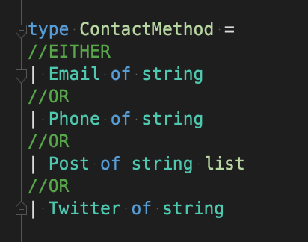
F# Algebraic Type System – Or Types
Notes:
And what if we introduce a new contact method into the system?

Slide 63
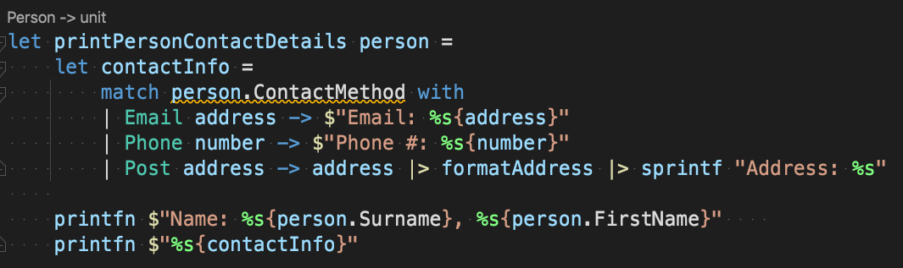
F# Algebraic Type System – Or Types
// [FS0025] Incomplete pattern matches on this expression. For example, the value 'Twitter (_)' may indicate a case not covered by the pattern(s).
Notes:
Well, here’s the kicker…as soon as we add a new choice to ContactMethod:
Everywhere our app consumes that type suddenly starts warning us about unhandled scenarios, so we know exactly where we need to go to cater for our new options and fix potential issues. This is because pattern matching in F# is exhaustive; the compiler is inspecting the Type system and comparing what you have handled to find any scenarios you’ve missed.
If you have turned on “Treat warnings as errors” then this will fail to compile, and you’ll need to update every function that does something with ContactMethod before you can continue.
This is exactly the sort of type safety that we .Net devs want to see, and reduces the chance of human error.

Slide 64
Leaning on the Compiler
F# Types
Notes:
Let’s look at some more features that help us do the right thing without too much cost or bother and see if we can save ourselves the trouble of writing a whole bunch of unit tests while we are at it.
Say we want to calculate the monthly repayment of a loan.

Slide 65
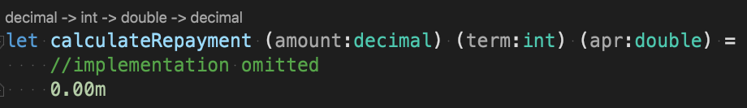
F# Types
Notes:
If we wanted to write a function for that, we’d probably start with something like this:
A calculateRepayment function that accepts a decimal, an int and a double, representing our loan Amount, loan Term, and APR…then returns a decimal representing our monthly repayment
…
The trouble with this is, there are several scenarios that either result in an error, because the input data is invalid, or we simply don’t want to calculate a repayment because it’s outside of what we as a business has appetite for:
For example, if the loan amount is too low, we don’t make enough money, if the loan amount is too big or the term too high, it’s too much risk. While negative numbers and zero are simply invalid!

Slide 66
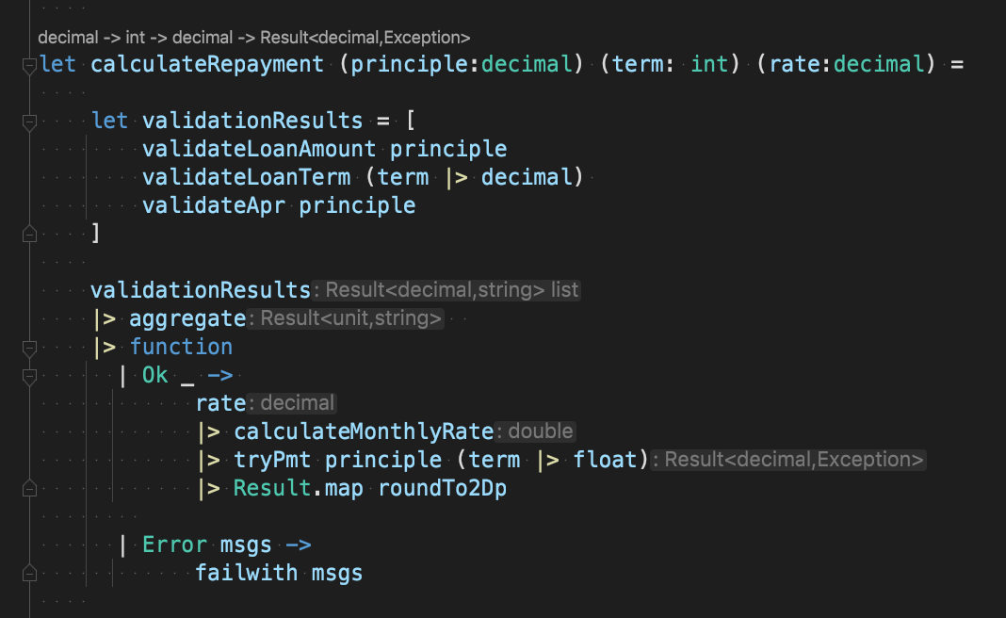
F# Types
Notes:
In this version, the code validates the inputs, and performs the calculation:
And this works, but there is a lot going on here!
What we really want, is to prevent all the invalid scenarios at the function signature level. To do that we need to create our own types with our business rules encoded into them.
Let’s do that with Loan Amount!!!

Slide 67
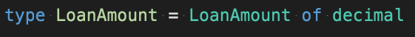
F# Types
Notes:
There you go, our loan amount type….defined on one line of code.
…
…
It’s a single case Discriminated Union (or a choice Type with only one option), and its constructor takes the raw decimal value that we want to wrap.
This obviously doesn’t include any business logic yet…I just wanted to demonstrate how easy it is to create your own types in F#.

Slide 68
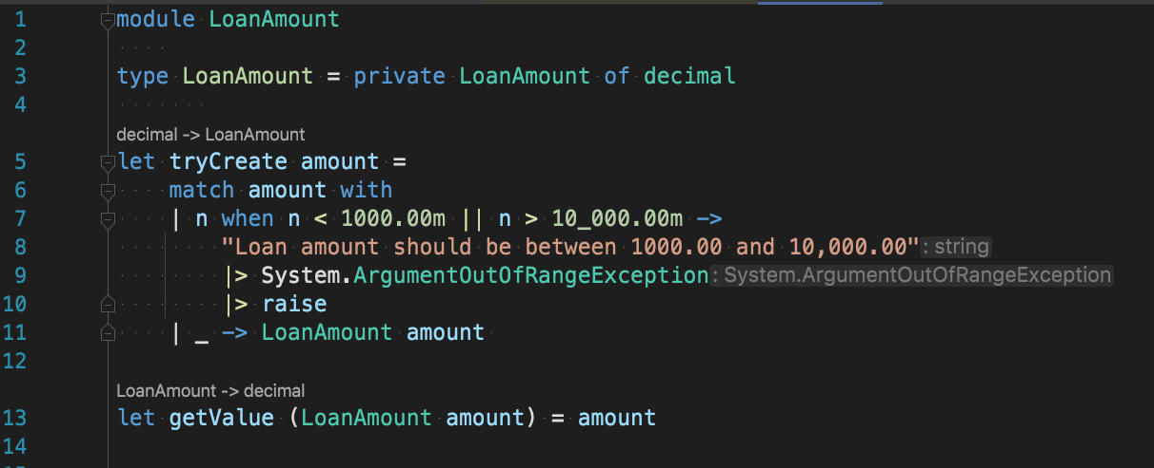
F# Types
Notes:
To encode our business rules into our type, we can do this:

Slide 69
F# Types
Notes:
We’ve declared that our LoanAmount Type now has a private constructor.

Slide 70
F# Types
Notes:
Then define a function to construct an instance for us: it’s in the same module, so can access the private constructor.
Try Create validates that the input argument meets our business rules;

Slide 71
F# Types
Notes:
if it does, it returns an instance of Loan Amount,

Slide 72
F# Types
Notes:
otherwise it Throws An exception…We’ll revisit this later to look at alternatives to Exceptions.
So, the only way to create an instance of Loan Amount now is via the Try Create function, and once you have an instance, you never need validate those rules again.

Slide 73
F# Types
Notes:
The last line defines a function that allows us to extract the inner value when we want to use it.

Slide 74
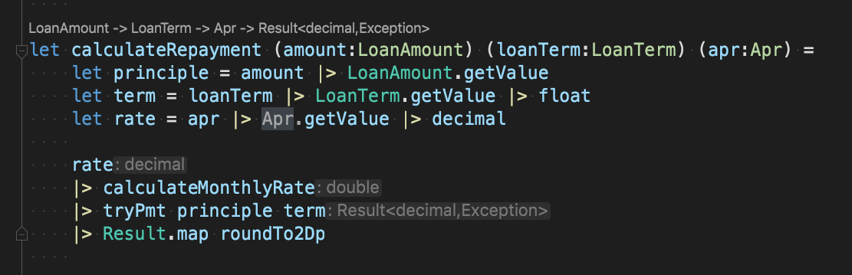

F# Types
Notes:
If we do the same for the other two inputs, and apply the changes we end up with a function that looks like this:
Now it’s impossible to invoke our calculate function with data that’s likely to cause errors, such as negative numbers, or numbers that we as a business don’t like!
This gives us several benefits:
Firstly, there is now a bunch of use cases we no longer need to write tests for….so that’s less code for us to maintain going forward
The code that performs the calculation is now only concerned with doing one thing… not validation, just the calculation. It’s simpler and easier to read, and easier to understand. And that validation is still happening…it’s just moved to somewhere else.
Finally, we can no longer supply our input arguments in the wrong order when we call the function, because while the underlying values of Loan Amount and Apr are both decimal, they are different types, so the compiler will prevent that, reducing the possibility of human error.
On top of that. Our single case DU is immutable and provides structural equality and a sensible override for ToString() all out of the box, so there is no extra code required.
And because you don’t have to override the default equality, you also don’t have to override GetHashCode, or not Equals … And you don’t need to write any tests for any of that code that you’ve not had to write…so that saves us time and effort too.

Slide 75
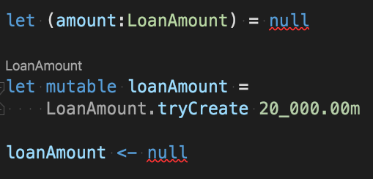
F# Types
// [FS0043] The type 'LoanAmount' does not have 'null' as a proper value
Notes:
And last but not least, you can’t the set the value of a discriminated union to Null….The compiler won’t let you, even if you enable mutability:
And this isn’t just true of primitives like decimal and Boolean! it’s true of all F# types: Records, Tuples and F# Lists.

Slide 76
Custom Types in F#
F# Types
Custom Types are easy and cheap to create
Easy to prevent illegal values at function signature level
Less guard clauses & validation in functions
Less Tests
High Confidence
Notes:
Custom types are cheap and easy to create.
Making illegal state completely unpresentable is easy to achieve, so we create less error prone code.
And you have less code, and less tests to maintain…

Slide 77

Custom Types in F#
F# Type Safety
•Custom Types are easy and cheap to create
•Easy to prevent illegal values at function signature level
•Less guard clauses & validation in functions
•Less Tests
•High Confidence
THERE IS
NO
NULL!
Notes:
Let’s double back for a second to that comment about Null.
“You can’t assign a null to a choice type.”

Slide 78
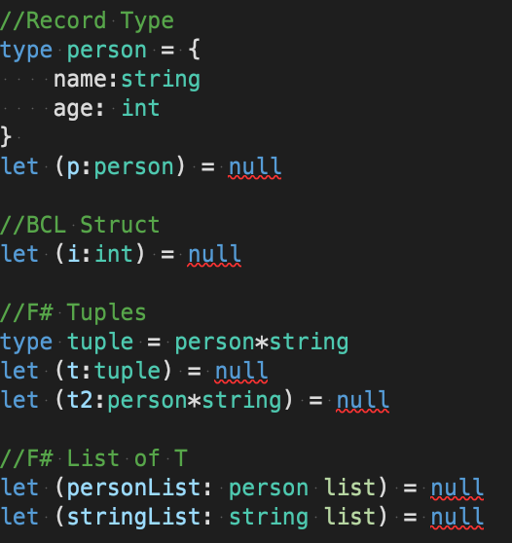
F# Type Safety
Notes:
Turns out, you can’t assign null to any F# types!
The only time you ever need worry about nulls is when dealing with reference types from the Base Common Library, such as strings, and when doing interop with OO .Net languages.
Imagine being able to write methods without the need to perform null checks before you do anything!
F# provides this behaviour out of the box for all its own types, and your custom types, which means you’ll see a lot less NullReferenceExceptions while writing F#, while also writing less code.

Slide 79
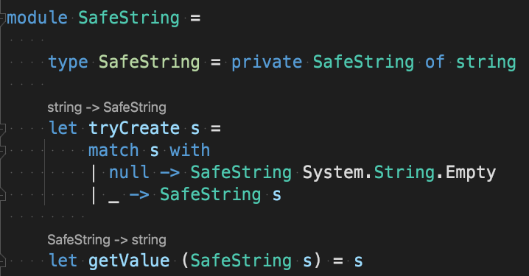
F# Type Safety
Don’t use this implementation. See fsharpforfunandprofit.com/posts/designing-with-types-more-semantic-types for a more complete example
Notes:
And If we wrap your strings in a custom type like we did with loan amount, with a creation method that filters out nulls ….then we can again prevent nulls at our function signature level.

Slide 80
Representing the absence of data…without Nulls
F# Type Safety – Option Type
•Null gives rise to Null Reference Exceptions
•Null is ambiguous:
Did something go wrong?
Was that a mistake?
Is there simply no data ?
Notes:
I don’t like Null, so go to great lengths to avoid, prevent, and eliminate them wherever possible, and therefore reduce the possibility of null reference exceptions.
But those exceptions are not the only issue with Nulls.
Null is Ambiguous…. does the fact that there is no data mean that there was no data? Or does it mean that something went wrong? Did someone miss something when they created the Object? Or is the data missing on purpose?
…
So, If we don’t have null, how do we represent the absence of data?
Well, Functional languages approach this in another way, with a built in Choice type
Which allows us to say: “this data isn’t mandatory, so it might be there, and it might not.”

Slide 81
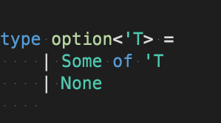
F# Type Safety – Option Type
Not actual implementation, just something I’ve knocked up!
Notes:
In F# this built-in type is called Option, and it’s implemented using a Discriminated Union that provides you with two choices: Some of T, or None.

Slide 82
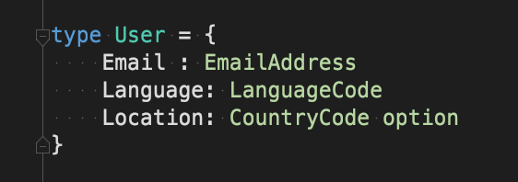
F# Type Safety – Option Type
Notes:
And here’s how we’d use it:
We define our User type as a record with 3 fields:
- Email & Language are required, because they are both defined with custom F# Types (EmailAddress & LanguageCode), and therefore required by default.
…

Slide 83
F# Type Safety – Option Type
Notes:
- Then we have Location, which is defined as a CountryCode Type…which is also a custom F# type, but it also has the option keyword here, indicating that the value is optional….so may or may not have a value.

Slide 84
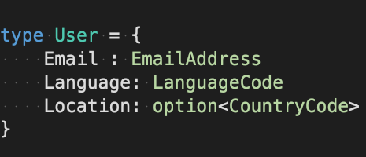
F# Type Safety – Option Type
Notes:
You could also define it like this if you prefer…which is probably more familiar if you are comfortable with Generics in C#, but those extra chevrons mean that the previous version is more common

Slide 85
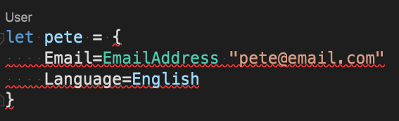
F# Type Safety – Option Type
// [FS0764] No assignment given for field 'Location' of type 'User'
Notes:
So, what impact does this have when we try to create an instance of our User Record?
Well, if we try to create it without specifying a Location you get a compiler error, because it’s a record, and all fields are required.

Slide 86
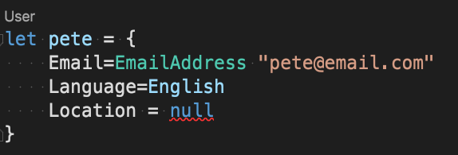
F# Type Safety – Option Type
// [FS0043] The type 'option<CountryCode>' does not have 'null' as a proper value
Notes:
If we try to set the value to Null, we get a different error, because…well Null is invalid:

Slide 87
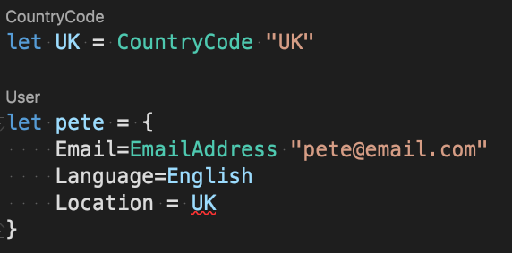
F# Type Safety – Option Type
// [FS0001] This expression was expected to have type 'option<CountryCode>' but here has type 'CountryCode'
Notes:
And if we try to set it to a valid CountryCode, we get another error entirely
…
So how DO we set a value then?
Well Option is a choice type, and if we think back to your ContactMethod example, we had to specify which of the available choices we were using, along with the data for that choice.
And we need to do the same with the Option Type:

Slide 88
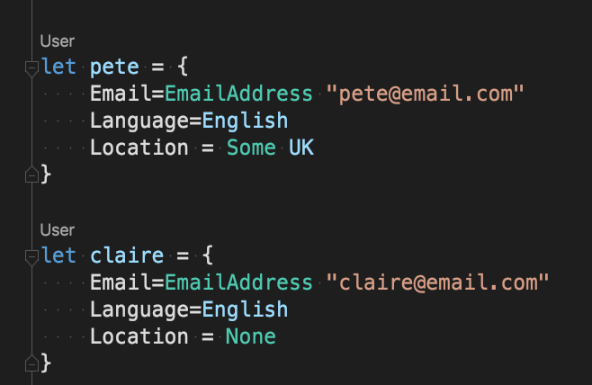
F# Type Safety – Option Type
Notes:
To create an instance with a Location, we specify the Some Choice, and the actual location data.

Slide 89
F# Type Safety – Option Type
Notes:
And to create an instance with No location, we supply the None Choice…. with no location Data.

Slide 90
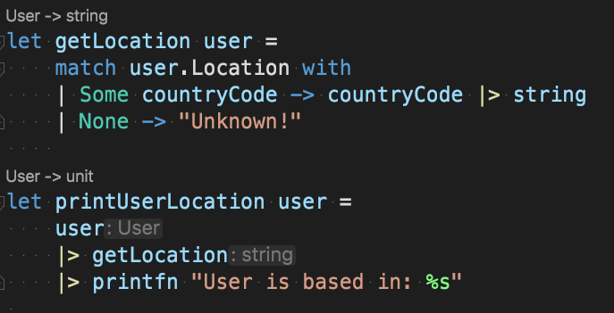
F# Type Safety – Option Type
Notes:
Then when you need to use your option type to do something, as with all Choice types, you need to handle all the available Choices when you pattern match on the value, as seen here in getLocation:
The compiler forces you to think about both the scenario where data is available (The Some choice), and, when there is None

Slide 91
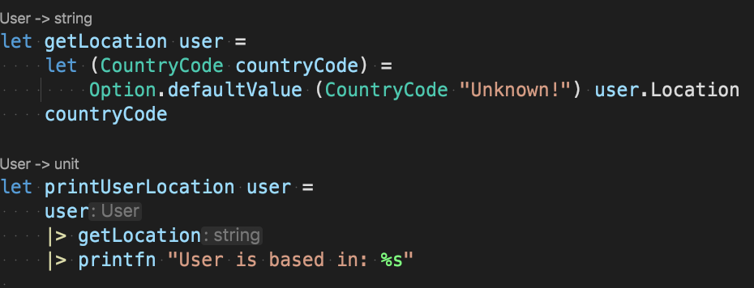
F# Type Safety – Option Type
Notes:
There is even an Option Module providing some common ways of working with Option Types:
In this implementation, getLocation calls Option.defaultValue, passing two arguments, the value to return if the option has no value, and the option itself. The supplied default is then returned if the option is None.

Slide 92
Optional Values
F# Type Safety – Option Type
Option Type is safer than Null
Unambiguous
Forces us to consider what happens when there is no data
Notes:
The Option Type provides an alternative way to model the absence of data,
which is less error prone than using Null
because it illuminates the possibility of Null Reference Exceptions,
while also forcing us to think about the absence of data when we access the value….so we can’t simply forget about everything off the happy path.

Slide 93
A different approach to Errors
F# Type Safety – Modeling Errors
“if you can model the ways something can fail in your domain, error handling code is no longer something you must deal with in addition to regular program flow.
It is simply a part of normal program flow, and not exceptional”
https://docs.microsoft.com/en-us/dotnet/fsharp/style-guide/conventions
Notes:
The Option.DefaultValue function leads us nicely into another area of programming where Functional chooses a different path to OO: Error handling.

Slide 94
Throwing Exceptions
OO
Undocumented side effects
Delegate work to the caller/consumer
Error handling code is ugly, repetitive, and breaks Single Responsibility Principle
Notes:
In OO, it’s common to perform lots of validation type checks to ensure that our input arguments meet our needs.
If everything is dandy, then we go ahead and perform the task at hand….construct the object or perform the calculation for example.
But when our inputs are invalid, we tend to Throw exceptions….
This has several implications on our code:
Undocumented side effects….the fact that an exception can be thrown is not documented in the method signature….it says: “you give me a and b, and I’ll give you C”….it doesn’t say, “you give me a and b and I’ll either give you C, OR throw an exception”!
Exceptions delegate work to the caller of the throwing method…the responsibility of preventing the application from crashing is now on the caller to ensure that they catch and handle any exceptions (which are probably undocumented), or let it bubble up in the hope that someone else will catch it.
Error handling code is ugly, repetitive, and depending on who you talk to; breaks the single responsibility principle….
The OO solution is a little opinionated….It says, “it’s my responsibility to work out if you are allowed to do this thing, so it’s my responsibility to decide what happens when I decide you can’t!”
F# can raise exceptions, as we saw in our LoanAmount Type, and handle them using syntax like try/catch/finally blocks, but it probably won’t surprise you to hear that the Functional approach offers several less opinionated solutions:
- Ask the caller what to do when things go wrong
- Return a choice type representing all the possible outcomes

Slide 95
Ask the caller/consumer
F# Type Safety – Modeling Errors
Simply ask what to do in the event of failure
Provide a default value or fallback function as an argument
Notes:
If we think back to Option.DefaultValue, you’ll recall that the first argument was a value to fall back on if the option type being evaluated contained None.
This is a common way of delegating the decision of what to do in the event of failure to the caller, rather than making that decision yourself…. Simply have it supplied as an argument.
Let’s have a look at some examples.

Slide 96
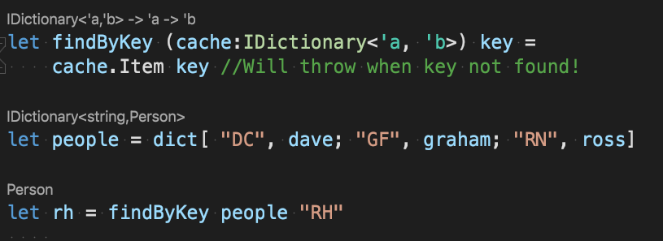
F# Type Safety – Modeling Errors
Notes:
Here’s some code that raises an exception:
On the last line we call the findByKey function, supplying the people dictionary and a key for the person we want to retrieve.
Only that key doesn’t exist in the dictionary, so when we attempt to retrieve it, a KeyNotFoundException will be thrown.

Slide 97
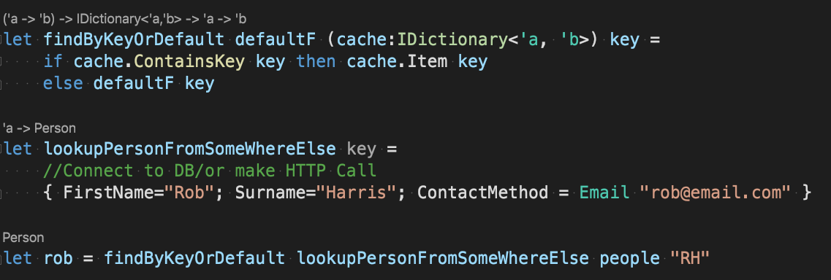
F# Type Safety – Modeling Errors
Notes:
What we could do instead is this:
This time the last line calls a findByKeyOrDefault function, passing in 3 arguments:
The dictionary and the key are the same as before, but the new argument is another function that also accepts a key and returns a person.
In the event of failure, the findByKeyOrDefault invokes this function, which goes off to somewhere else to lookup the data using the same key.
This is a technique I use in my OO code quite a bit since l started learning F#:
It ports well to both C# and Python in my opinion.

Slide 98
Returning a Choice Type
F# Type Safety – Modeling Errors
Return one of N possible Choices
Notes:
Now let’s take a look at the other technique; returning a Discriminated union…or….. “return one of multiple choices”.
Let’s say we want to read the contents of a file from disk
There are several things that could go wrong here, but let’s say that we can have 3 error scenarios:
Directory Not found
The file does not exist
Or the file may simply be empty (not strictly an error, but the content is not useful!)
And of course, everything could be just fine, and the read could succeed.

Slide 99
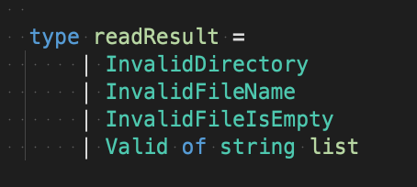
F# Type Safety – Modeling Errors
Notes:
We can model each of those scenarios in a Discriminated union like so:
With one choice for each of the different scenarios.

Slide 100
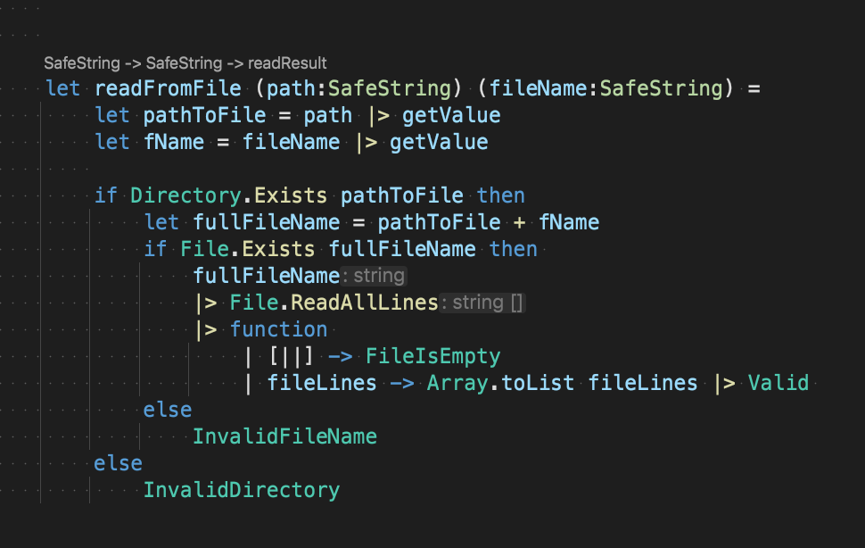
F# Type Safety – Modeling Errors
Notes:
Then, our readFromFile function can return each of these different possible values under different conditions.

Slide 101
F# Type Safety – Modeling Errors
Notes:
In the function signature we define 2 input arguments of type SafeString…so no need to check for null.

Slide 102
F# Type Safety – Modeling Errors
Notes:
If the directory doesn’t exist, we return the InvalidDirectory choice.

Slide 103
F# Type Safety – Modeling Errors
Notes:
If the requested file doesn’t exist in that directory, we return InvalidFileName.

Slide 104
F# Type Safety – Modeling Errors
Notes:
If we locate the file,
we then read the content, and check to see if the array created by ReadAllLines is empty or not,
if its empty, we return FileIsEmpty,
otherwise, we convert the array to a list, and return the Valid choice, with a list of strings representing the lines of the file we read.

Slide 105
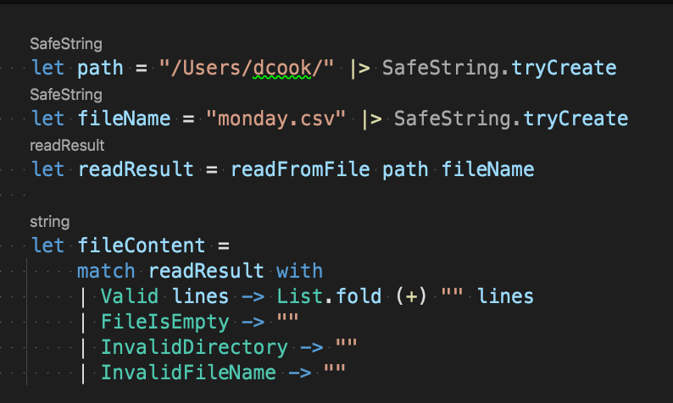
F# Type Safety – Modeling Errors
Notes:
Then when we invoke the function and deal with the response,...
We do what we always do with Choice types, and deal with all the available choices

Slide 106
F# Type Safety – Modeling Errors
Notes:
I’ve chosen to cheat and simply return an empty string for all our error scenarios, while the success scenario simply concatenates those multiple lines into one string for us.

Slide 107
A different approach to Errors
F# Type Safety – Modeling Errors
Both options reduce the change of exceptions
Both options document all possible outcomes in the function signature
Discriminated Union approach so common, there is a built in Type: Result
Notes:
F# gives you multiple options on top of throwing Exceptions:
Ask the Caller
Return a Choice Type
Both options reduce the chance of errors crashing the application, because neither raises an exception and then relies on the caller, or something further up the stack, to catch and handle that exception.
And in both cases, particularly when returning a DU, you can infer from the function signature how a function is likely to behave when you call it….the signature tells us exactly what is going to happen:
You give me a & b, and I’ll give you c… or invoke/return y
Or
You give me a & b, and I’ll give you either: x, y or z

Slide 108
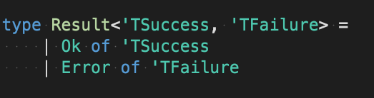
F# Type Safety – Modeling Errors
Again, not the actual Type definition…. just something I’ve put together as an example
Notes:
The Discriminated Union method is such a common pattern in F#, that the language includes a Type for this very purpose: the ResultType, as seen here.
It’s a Discriminated Union with two choices – Ok, or Error, each with their own data type for their scenario.

Slide 109
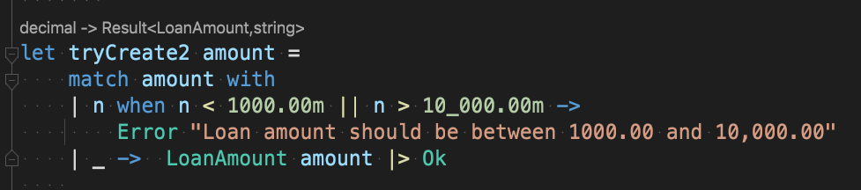
F# Type Safety – Modeling Errors
Notes:
Here’s an example of how you might see this used:
I’ve refactored our TryCreate function from the LoanAmount module we saw earlier,

Slide 110
F# Type Safety – Modeling Errors
Notes:
so now instead of throwing an Exception when validation fails, we return the Error choice, with a string that holds the validation error message.

Slide 111
F# Type Safety – Modeling Errors
Notes:
And when validation passes, we return the Ok choice containing the LoanAmount value.

Slide 112
F# Type Safety – Modeling Errors
Notes:
You can see that the type annotations above the function says: you give me a decimal, and I’ll give you a Result of either a Loan Amount, or a string.
As a final note: the language guidelines point out that ResultType and Discriminated Unions are not a complete replacement to exceptions, and that exceptions are better suited to certain scenarios.
These are generally truly exceptional scenarios though, rather than those that are easily expected or anticipated.

Slide 113

Anyone for Curry?
F# Partial Application
Notes:
So the last big thing I’d like to cover today is very different to what we are used to with C#, but may be more familiar for the JavaScript folk among us, and that is Currying & Partial Application

Slide 114
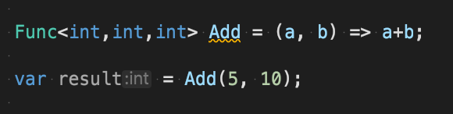
C#
Notes:
In C#, when we call a method or a function, we specify all the required arguments.
You don’t really have a choice because the compiler complains if any are missing.
…

Slide 115
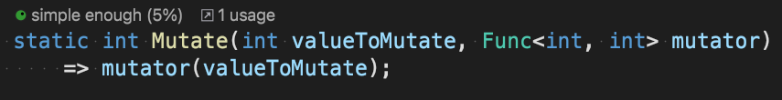
C#
Notes:
So, if you had the following function in C#,
and we want to supply our add function as an input, then we need to adapt it somehow so the function signatures match, otherwise you get a compiler error: because Add requires two inputs, while the mutator Func only accepts one.
…
Currying is the act of transforming a function that takes N arguments all at the same time, and turning it into a series of functions that all accept one argument.

Slide 116
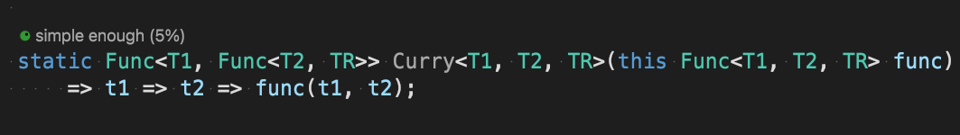
C#
Notes:
And it might look something like this in C#, expressed as a generic extension method.
…
I’ll skip over the details, and focus on what this gives you:

Slide 117
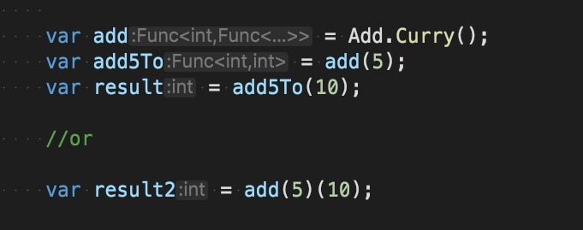
C#
Notes:
Having called Curry on a function, we can now supply the arguments individually, rather than all at the same time.
Applying the first argument returns another function that still requires the last argument.

Slide 118
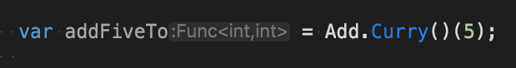
C#
Notes:
This is referred to as Partial Application.
Here, we have a partially applied add function which requires one more argument before you get our result.
Now this all works, but it comes with some costs:
You need to write the Currying code yourself, or pull in a functional library such as Language Extensions. (https://github.com/louthy/language-ex)
And if you want to curry functions with more than 2 arguments, you need multiple overloads for the Curry method, each accepting a different number of arguments.
The compiler will only let you create Funcs with up to 16 inputs, so there is an upper limit. Although if you are hitting this limit, you should probably refactor and create some types!

Slide 119
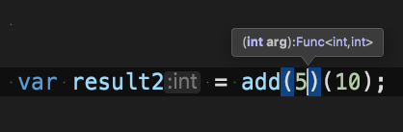
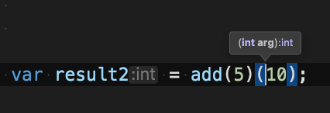
C#
What does ‘arg’ mean here?!?!?
Notes:
You have also bamboozled your IDE, which no longer has any idea what your input argument names are, because everything is so generic, and we lose useful intellisence
F# solves these problems out of the box! Because it automatically returns a new function with N less required arguments whenever you call a function with less than the required amount:
…
Basically…. its Auto currying for you!

Slide 120

F# Partial Application
Notes:
Here’s the code we saw before in F#

Slide 121
F# Partial Application
Notes:
On line 2 we supply one argument to the existing Add function….
This then returns a new function, which we bind to the AddFive symbol.
AddFive still requires a single integer applying to invoke a result:

Slide 122
F# Partial Application
Notes:
you can see the IDE highlighting the method signature above…it’s a function that accepts and int and returns an int.

Slide 123
F# Partial Application
Notes:
Result2 is then created by applying the remaining argument to AddFive

Slide 124
F# Partial Application
* Only works with Curried arguments, not Tupled arguments. See https://bit.ly/31m6P8x for info
Notes:
And Result3 is created when we call the Mutate function, passing in the addFive function as an argument.
This all happens without the need for us to write any Currying code ourselves.
Any time you call a function with less than the expected number of arguments, you get a new function back, which still requires the remaining arguments

Slide 125
Why? How is this useful?
F# Partial Application
Notes:
Ok, but why?
Why would you want this behaviour, and how can you benefit from it when building applications?
What this gives us is the ability to apply N arguments now, and apply the remaining arguments later, without losing the option to supply them all at once if we choose.
The use cases for this are varied.
The example we just saw is like a Functional version of the Adapter Design Pattern:
changing the API of existing code to make it usable in new scenarios.

Slide 126

F# Partial Application
Notes:
It’s also useful for composition.
For example, We can refactor this code by turning each of these multi argument functions into single argument functions, to create the following, which does exactly the same, but is much easier to understand.

Slide 127

F# Partial Application – for composition
Notes:
And of course, we can turn any function into a one argument function using partial application!
Which means we can do this with any function!

Slide 128

F# Partial Application – for code reuse
Notes:
You may have also spotted another use case in this code: reuse!
FilterNumbers and FilterSpecialChars are both specialised versions of the filter function, with the first argument already applied.
They both require the final string argument for the filtering to take place.

Slide 129
F# Partial Application – for code reuse
Notes:
You can see the function signatures tell us they both accept a string and return a string, even though the new functions have no input arguments declared.
This is because they return a function that expects an input argument.

Slide 130

F# Partial Application – Dependency Injection
Notes:
The final use case I’ll discuss is what you might describe as a Functional form of Dependency Injection, not via interfaces into constructors as with OO, but via functions.
Consider this function for fetching a customer record from a database by ID.
It uses the supplied configuration record to get a MongoColleciton of Customers.
Then queries that collection for the matching customer

Slide 131

F# Partial Application – Dependency Injection
Notes:
We want to call this function from our application in our printCustomerDetails function

Slide 132
F# Partial Application – Dependency Injection
Notes:
But if we call this directly, via [module name] DOT [function name], then we tightly couple the calling function to a concrete implementation of the getCustomer function…just as you would if you had new’d up an instance of a data access class in OO.

Slide 133

F# Partial Application – Dependency Injection
Notes:
To solve this, we inject a dependency into the function instead, by supplying it as an input argument:

Slide 134
F# Partial Application – Dependency Injection
Notes:
Now our printCustomerDetails function accepts 4 arguments instead of 2:
The dbConfig record and the customer ID as before
Plus 2 additional functions
One to retrieve the collection to query
and another to get the customer from that collection
Notice there is no reference to an interface here at all, but we are achieving the same result using method signatures as our contracts, which the compiler enforces.

Slide 135
F# Partial Application – Dependency Injection
Notes:
I’ve created a Type for GetCustomerF here to clean up this example, and fit the function signature all on screen.
...
You don’t NEED to do this, as type inference knows what is going on, but it can make code more readable when signatures get quite long.

Slide 136
F# Partial Application – Dependency Injection
Notes:
This is better,
but now we are supplying arguments to printCustomerDetails that it doesn’t use except to pass on to the getCustomer Function.
This is where partial application can help us clean this up.

Slide 137

F# Partial Application – Dependency Injection
Notes:
In this final version of printCustomerDetails we now supply just the GetCustomer function, and a customer ID.
When we invoke the function, we get a customer back, and we can access the customer details.
This is possible because somewhere else in the application, probably our composition root which is executed as the application launches, we have created a new function by applying the first 2 arguments (dbConfig and getCollection), and our app is then using this new function at run time when calling printCustomerDetails

Slide 138

F# Partial Application – Dependency Injection
Notes:
Here is a unit test that simulates that process:
…
…

Slide 139
Summary
F#
Write Safer, less error prone code
Eliminate nulls, & therefore null reference exceptions
Immutable by default
Easily express your Business Logic within custom Types
Notes:
That’s all we have time to cover today.
Hopefully, I’ve been able to sufficiently demonstrate the things I believe makes F# a compelling tool, and which should make our lives as .Net Devs easier and more productive:
by writing less code and less tests,
writing code that is less prone to error,
while also being more expressive, and therefore easier to read, understand and change.
F# can do everything you can do today with .Net in C#, but it’s take’s a different approach.
If you are already:
Trying to make everything immutable
Encoding Business Rules into types
Avoiding throwing Exceptions
Avoiding & eliminating Nulls
Favouring expressions over statements
Or questioning the need for interfaces
Then you should absolutely give F# a go.
At the end of the day, each of us is really trying to deliver more value to our customers and end users faster, and it’s my belief that F# will allow us to do just that.
But, even if you decide that F# is not for you, the act of learning it will give you a new way of looking at problems, and therefore new approaches to solving those problems, which ultimately makes us all better Devs.
I expect once you give it a try, it will impact the way you write Object Oriented code, and you’ll embrace more and more of the functional features that have been added to C# in recent years.

Slide 140
Next Steps
F#
The slides, and all the code can be found here:
The repo contains a list of F# learning resources
Check out the F# Foundation, F# Mentorship Program and the F# Slack community
Notes:
If you are interested in learning more, I have put together a list of resources to help get you on your way, including books, videos, and websites, and people to follow on Twitter for even more content.
It’s worth noting that the F# Foundation run something called the F# Mentorship program at least once a year: if you are lucky enough to get selected, they pair you up with a mentor for at least 8 weeks, who will help you delve into some of these things, as you work together to hone your skills.
Oh, and it’s Free!
There is also a very active F# Slack community, with lots of friendly folks willing to answer questions.

Slide 141
Questions
All slides &, code samples: https://bit.ly/2XxVZuC
Learning Resources: https://bit.ly/3lZGR2k
@dcook_net
@cookie

